Slide 1
Week 14 Presentation
By J. Jedediah Smith

Slide 2
What was tried?
Increasing number of cores used
Setting a memory limit
Down sampling the data
Running Kraken2 in a Conda Environment
Comparing BugSeq submissions
Retrieving Mac laptop
Installing programs on Mac laptop

Slide 3
How did it go?
All of the following resulted in the same errors as before:
Increasing the number of cores with SBATCH
Setting a memory limit with SBATCH
Using down sampled data with (and without) the previous settings
Using the Kraken2 conda environment
Successfully retrieved Mac laptop and installed conda but:
Kraken2 not designed for Mac, documentation said explicitly it might not work. Did not work, said there was a bunch of file conflicts.
CCMetagen did install! But the reference database is 95 GB and the computer only had 94 GB of space. So, I uninstalled unimportant programs (iMovie, Garage Band) and got 100 GB of storage, but it still said not enough space.
Got another set of BugSeq data to compare against.

Slide 4
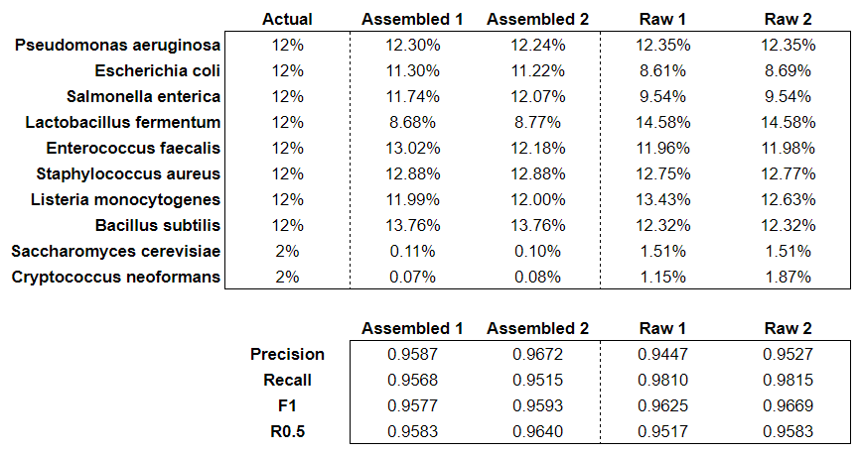
BugSeq Comparison

Slide 5
Where to go next?
Keep trying with the Mac laptop?
BugSeq inquiries
Can it use assembled short reads?
Can the reference database/genome be changed? Which does it use?
Olena lab computers?
Work on final write up.

